Slide 2
Group, group, group
One after the other: cmd1 ; cmd2
One or both: cmd1 && cmd2
Only one of them: cmd1 || cmd2
Cuddling (there): ( cmd1 ; cmd2 )
Cuddling (here): { cmd1 ; cmd2 }

Slide 3
if condition1
then
statements
elif condition2
more statements
[…]
else
even more statements
fi

Slide 4
if grep -q root /etc/passwd
then
echo root user found
else
echo “No root???”
fi

Slide 5
Twice the same
if [ -e /etc/passwd ]
then
echo /etc/passwd exists
else
echo /etc/passwd does NOT exist
fi
if test -e /etc/passwd
then
echo /etc/passwd exists
else
echo /etc/passwd does NOT exist
fi

Slide 6
case variable in
pattern1)
statements_1
;;
pattern2)
statements_2
;;
[…]
*)
statements_3
;;
esac

Slide 7
case $PATH in
*/opt/* | */usr/* )
echo /opt/ or /usr/ paths found in \$PATH
;;
*)
echo ‘/opt and /usr are not contained in $PATH’
;;
esac

Slide 8
for variable in list
do
statements
done

Slide 9
Twice the same again
for FILE in /tmp/*
do
echo “ * $FILE”
done
for FILE in `ls /tmp`
do
echo “ * $FILE”
done

Slide 10
while condition
do
statements
done
until condition
do
statements
done

Slide 11
Manual Loop Control
Notes:
PLEASE CORRECT IN SCRIPT: $MYDIR=/etc -> MYDIR=/etc

Slide 12
Script Flexibility: Variables
Instead of
#!/bin/sh
echo “The directory /etc contains the following files:”
ls /etc
use
#!/bin/sh
MYDIR=/etc
echo “The directory $MYDIR contains the following files:”
ls $MYDIR
Notes:
PLEASE CORRECT IN SCRIPT: $MYDIR=/etc -> MYDIR=/etc

Slide 13
Script Flexibility: Settings File
Create a settings file:
MYDIR=/etc
And source it in your script
#!/bin/sh
. ./settings.ini
echo “The directory $MYDIR contains the following files:”
ls $MYDIR
Notes:
PLEASE CORRECT IN SCRIPT: $MYDIR=/etc -> MYDIR=/etc

Slide 14
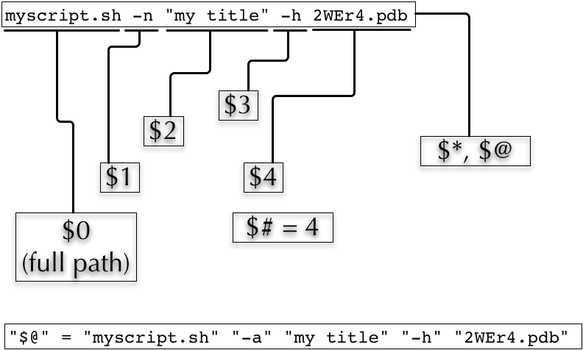
Script Flexibility:
Commandline Parameters
Notes:
PLEASE CORRECT IN SCRIPT: $MYDIR=/etc -> MYDIR=/etc

Slide 15
Script Flexibility:
Walking through the Commandline Parameters
Notes:
PLEASE CORRECT IN SCRIPT: $MYDIR=/etc -> MYDIR=/etc
15

Slide 16
Script Flexibility:
Applying the case statement
while [ "$#" –gt 0 ]
do
case $1 in
-h) echo “Sorry, no help available!” # not very helpful, is it?
exit 1 # exit with error
;;
-v) VERBOSE=1 # we may use $VERBOSE later
;;
-f) shift
FILE=$1 # Aha, -f requires an
# additional argument
;;
*) echo “Wrong parameter!”
exit 1 # exit with error
esac
shift
done
Notes:
PLEASE CORRECT IN SCRIPT: $MYDIR=/etc -> MYDIR=/etc

Slide 17
Script Flexibility:
Unsolved cases regarding commandline parameters
How to handle multiple instances of the same parameter?
How to handle commandline arguments which are not options?
Notes:
PLEASE CORRECT IN SCRIPT: $MYDIR=/etc -> MYDIR=/etc

Slide 18
Ending a script properly:
The Exit Status
There is always an exit status: The exit status of the last command run in the script
The exit status of the last run command is available in the $? variable
Either you control the exit status or it controls you
Notes:
PLEASE CORRECT IN SCRIPT: $MYDIR=/etc -> MYDIR=/etc

Slide 19
Ending a script properly:
The Exit Status – miserable failure
Ran the following scripts on the cluster
#!/bin/sh
[... Lots of processing steps. One of them failed ...]
Echo “End of the script”
The jobs apparently failed (no result files were written) but there were no entries in the error file and the cluster administrators confirmed repeatedly, that all these scripts ran fine and successfully
WHY?
Notes:
PLEASE CORRECT IN SCRIPT: $MYDIR=/etc -> MYDIR=/etc

Slide 20
Ending a script properly:
The Exit Status – good solution
This solved the situation
#!/bin/sh
mystatus=0;
[... do something that might fail ...]
if [ $? -ne 0 ]
then
mystatus=1
fi
[... do something else that might fail, too ...]
[ $? -ne 0 ] && mystatus=1 # same as above. Do you understand
# this?
echo "End of the script"
exit $mystatus
The exit status had controlled us, but now we are back in control
Notes:
PLEASE CORRECT IN SCRIPT: $MYDIR=/etc -> MYDIR=/etc

